Slide 1
Intro to LaTeX
QBS 103: Foundations of Data Science
August 12, 2025

Slide 2
Lecture Objectives
At the end of this lecture you should be able to:
Create a basic document in LaTeX
Typeset mathematical equations
Apply basic formatting
Generate references

Slide 3
Resources
LaTeX Editors
Overleaf: https://www.overleaf.com/edu/dartmouth As as a Dartmouth student, you have free access to Overleaf.
Open Source Reference Managers
Mendeley: https://www.mendeley.com/
Zotero: https://www.zotero.org/

Slide 4
The Basics: Why use LaTeX?
Create clean, formatted scientific documents
Provide the same entered base text and easily apply any formatting afterwards (i.e. focus on content first, don’t worry about formatting as you write)
Easy typesetting for mathematical equations and references, consistently formatted across all documents

Slide 5
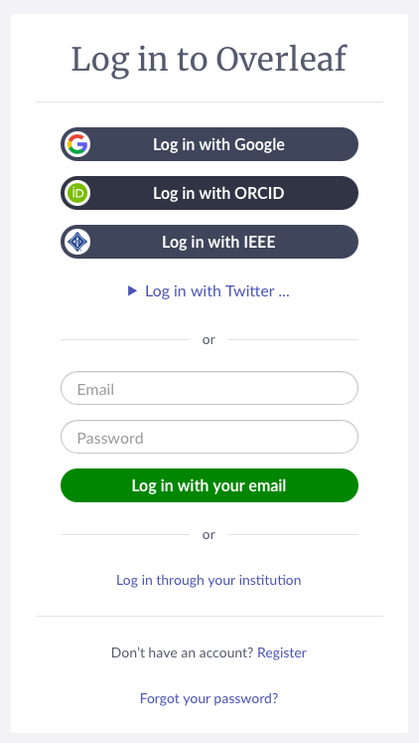
Accessing Overleaf
Log in to Overleaf with your Dartmouth credentials using “Log in through your institution”.
As long as you log in through Dartmouth, you should see that you have access to a premium overleaf subscription.

Slide 6
Starting a New Document
LaTeX files use the extension .tex
At a minimum, every new .tex file you start needs to contain the following lines:
\documentclass{article}
\begin{document}
[Document Content]
\end{document}
Unlike in R where we use # to indicate comments, in LaTeX we use %

Slide 7
Building Our Document
We can add additional features to our document using features like these:
\documentclass{article}
\title{your title here}
\author{your name here}
\date{your date here}
\begin{document}
\maketitle % inserts text for your title as defined above
\tableofcontents %automatically generates based on sections, subsections, etc defined in your document
\section{your section name here}
\subsection{your subsection name here}
You can also add text as you want it to appear throughout just by typing.
\end{document}

Slide 8
Typesetting Equations
Whenever we’re typing an equation we use the following syntax to denote that the text inside reflects a mathematical equation.
On a New Line: \[ your equation here \]
In Line with Text: $ your equation here $
\( your equation here \)
\begin{math} your equation here \end{math}
https://www.overleaf.com/learn/latex/Mathematical_expressions

Slide 9
Typesetting Equations
Mathematical Symbols https://www.overleaf.com/learn/latex/List_of_Greek_letters_and_math_symbols#Binary_Operation/Relation_Symbols
Brackets and Parentheses https://www.overleaf.com/learn/latex/Brackets_and_Parentheses
Integrals, Subscripts, and Superscripts https://www.overleaf.com/learn/latex/Subscripts_and_superscripts

Slide 10
Using Typeset Equations in R Markdown
To drop an equation you’ve already typeset into markdown, simply enter it with the following syntax in a text chunk (not a code block) of your markdown file to start it on a new line:
$$ your equation here $$
You will see the formatted equation appear immediately in your markdown window (no need to run any code) and in your final knitted document.

Slide 11
Building Tables in LaTeX
Tutorial: https://www.overleaf.com/learn/latex/Tables
Easy Table Generator: https://www.tablesgenerator.com/

Slide 12
Applying Formatting
The geometry package can be used to define a basic layout for your document like this:
\usepackage{geometry}
\geometry{total = {8.5in,11in}, margin=1in}

Slide 13
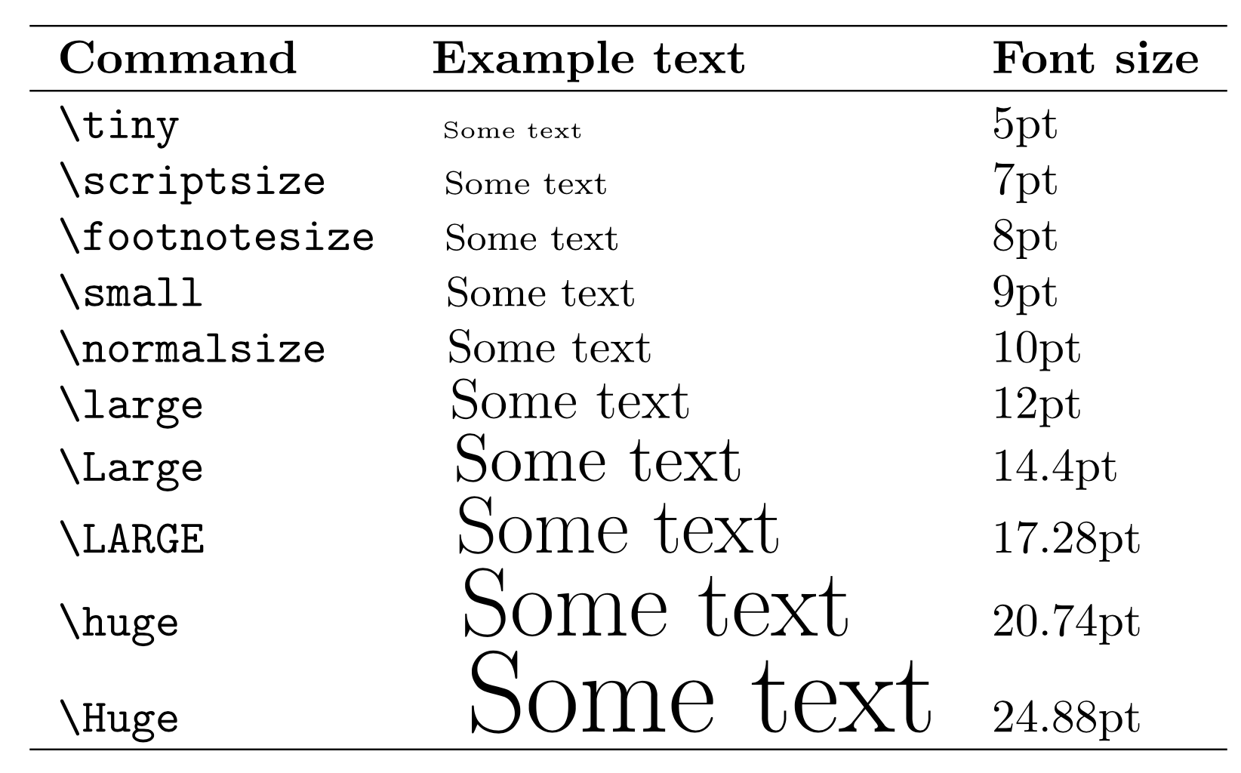
Applying Formatting
You can set a base font size in the “document class” line like this:
\documentclass[size]{class}
“article” accepts sizes: 10pt, 11pt, 12pt
“extarticle” accepts sizes: 8pt, 9pt, 10pt, 11pt, 12pt, 14pt, 17pt, 20pt
Then, you can change the relative size of text within the document using commands to the right.
Relative Sizes Based on 10pt Base Font
Change font: https://www.overleaf.com/learn/latex/Font_typefaces

Slide 14
Adding in References
To add formatted references to a LaTeX, all you need is a .bib file which you can easily export from most citation managers. Add this file to your folder.
At the end of your document, add this:
\bibliographystyle{format you want to use}
\bibliography{file name (no .bib extension)}
Note, the bibliography will be blank until you cite specific articles. Which you can do with the following command in line:
\cite{citation name}

Slide 15
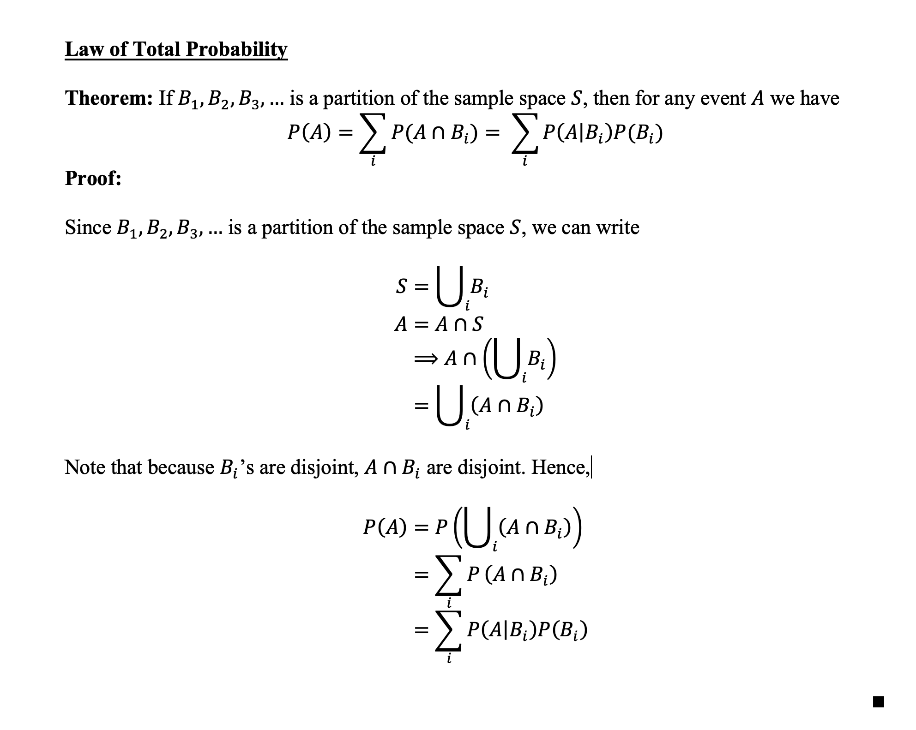
Adding Images
To add an image to your LaTeX document, first add it to your folder in Overleaf.
Add this to the top of your document:
\usepackage{graphicx}
\graphicspath{ {./images/} }
And call it inline like this
\includegraphics{image name}

Slide 16
In Class Activity
Typeset the following proof in LaTeX:

